Slide 1


Vidyavardhaka College of Engineering, Mysuru
Autonomous Institute, Affiliated to VTU
Accredited by NBA | NAAC with ‘A’ Grade
Module 4 : Code Generation

Slide 2
Topics to be covered ..
The Target language.
Basic blocks and flow Graph.
Optimization of basic blocks.
The code – generation algorithms.
Introduction to Assembler
Machine architecture for SIC and SIC/XE.
Basic Assembler functions.
SLT: Issues in the design of a code generator

Slide 3
The Target language
The target machine and its instruction set is a prerequisite for designing a good code generator.
8.2.1 A Simple Target Machine Model
Our target computer models a three-address machine with load and store operations, computation operations, jump operations, and conditional jumps.
The underlying computer is a byte-addressable machine with n general-purpose registers, R0, R1, . . . , Rn - 1.
Following Kinds of Instructions are available
Load operation ---- example : LD dest , scr --------- assignment operation dest = src.
LD r , x
LD r1,r2

Slide 4
2. Store Operation : Example ST x , r --- stores the value in register r into x. i.e., x = r.
3. Computation Operation :
Op dst, src1,src2
Where op is operator like ADD, SUB,MUL
example : sub r1,r2,r3 ==🡺 r1 = r2 – r3
4. Unconditional Jump :
The instruction BR L causes control to branch to the machine instruction with label L.
5. Conditional Jump :
Bcond r, L, where r is a register, L is a label, 🡺 cond stands for any of the common tests on values in the register r.
For example,
BLTZ r, L causes a jump to label L if the value in register r is less than zero, and allows control to pass to the next machine instruction if not.

Slide 5
Target machine has a variety of addressing modes
In instructions, a location can be a variable name x referring to the memory location that is reserved for x.
Indexed address of the form a(r)
Example : LD R1 , a ( R2) 🡺 R1 = contents ( a + contents(R2)).
Memory location can be an integer indexed by a register.
For example,
LD R1, l00(R2) has the effect of setting R1 = contents(100 + contents(R2))
Indirect addressing modes :
Example : LD R1 , *100(R2) 🡺 R1 = contents(contents(l00 + contents(R2)))
Immediate Addressing Mode :
Example : LD R1 , #100

Slide 6



Example : The three-address statement can be implemented by the machine instructions:
X = y – Z
b = a[i]
3. a [j] = c

Slide 7



x = *p
*p = y
If ( x < y) goto L

Slide 8
Basic Blocks and Flow Graphs
The representation is constructed as follows:
Partition the intermediate code into basic blocks, which are maximal sequences of consecutive three-address instructions with the properties that
(a) The flow of control can only enter the basic block through the first instruction in the block. That is, there are no jumps into the middle of the block.
(b) Control will leave the block without halting or branching, except possibly at the last instruction in the block.
2. The basic blocks become the nodes of a flow graph, whose edges indicate which blocks can follow which other blocks.

Slide 9
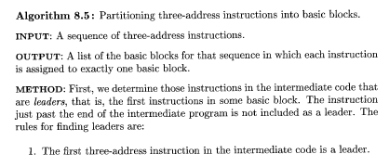

Basic Blocks
To partition a sequence of three-address instructions into basic blocks.

Slide 10
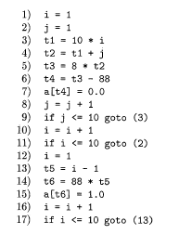
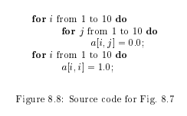
Example
The leaders are instructions 1, 2, 3, 10, 12, and 13.

Slide 11
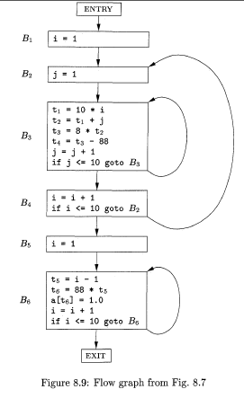
Flow graph

Slide 12
Optimization of Basic Blocks
Improvement in the running time of code merely by performing local optimization within each basic block by itself. More thorough global optimization, which looks at how information flows among the basic blocks of a program.
The DAG Representation of Basic Blocks:
Many important techniques for local optimization begin by transforming a basic block into a DAG (directed acyclic graph).

Slide 13
To Construct a DAG for a basic block as follows:
1. There is a node in the DAG for each of the initial values of the variables appearing in the basic block.
2. There is a node N associated with each statement s within the block. The children of N are those nodes corresponding to statements that are the last definitions, prior to s, of the operands used by s.
3. Node N is labeled by the operator applied at s, and also attached to N is the list of variables for which it is the last definition within the block.
4. Certain nodes are designated output nodes. These are the nodes whose variables are live on exit from the block; that is, their values may be used later, in another block of the flow graph. Calculation of these "live variables" is a matter for global flow analysis

Slide 14
The DAG representation of a basic block lets us perform several code improving transformations on the code represented by the block.
a) We can eliminate local common subexpressions, that is, instructions that compute a value that has already been computed.
b) We can eliminate dead code, that is, instructions that compute a value that is never used.
c) We can reorder statements that do not depend on one another; such reordering may reduce the time a temporary value needs to be preserved in a register.
d) We can apply algebraic laws to reorder operands of three-address instructions, and sometimes thereby simplify the computation.

Slide 15
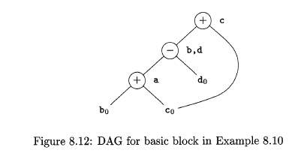
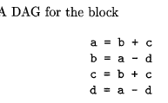
Finding Local Common Subexpressions
Common subexpressions can be detected by noticing, as a new node M is about to be added, whether there is an existing node N with the same children, in the same order, and with the same operator.
Example :

Slide 16
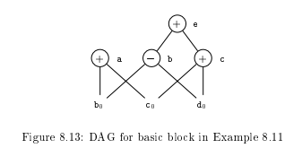


Slide 17
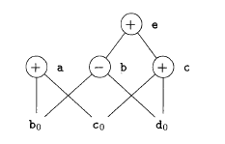
Dead Code Elimination
The operation on DAG's that corresponds to dead-code elimination can be implemented as follows. We delete from a DAG any root (node with no ancestors) that has no live variables attached. Repeated application of this transformation will remove all nodes from the DAG that correspond to dead code.
Example :
a and b are live but c and e are not,
we can immediately remove the root labeled e.
Then, the node labeled c becomes a root and can be removed.
The roots labeled a and b remain, since they each
have live variables attached.

Slide 18




The Use of Algebraic Identities
Algebraic optimizations includes local reduction in strength, that is, replacing a more expensive operator by a cheaper one as in:
Example :

Slide 19
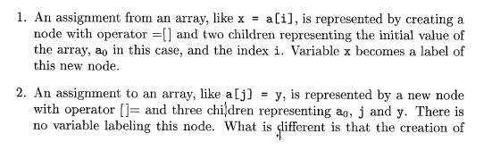

Representation of Array References
The proper way to represent array accesses in a DAG is as follows.

Slide 20
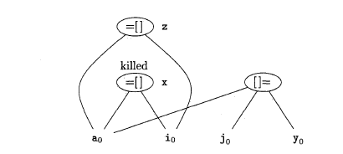
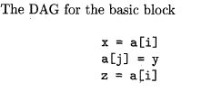
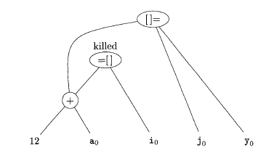

Example

Slide 21
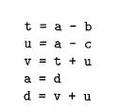
The Code-Generation Algorithm
Example :

Slide 22
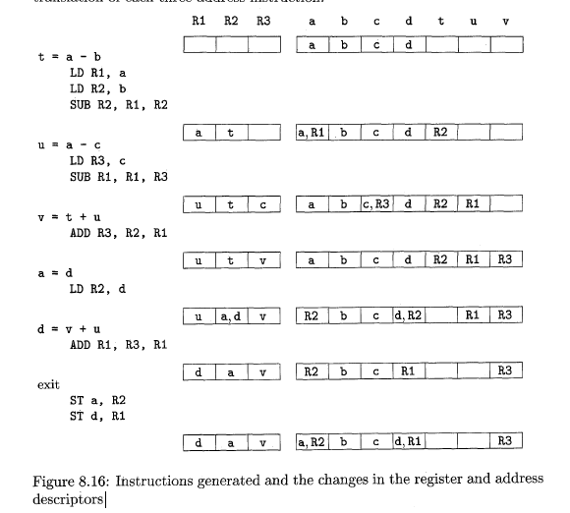

Slide 23
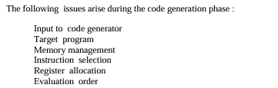
ISSUES IN THE DESIGN OF A CODE GENERATOR

Slide 24
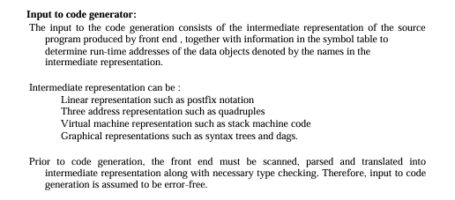

Slide 25
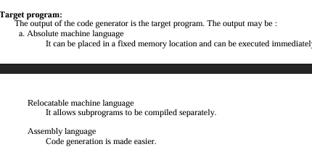

Slide 26
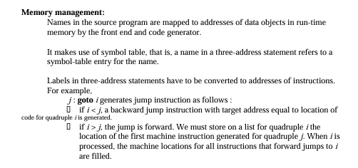

Slide 27
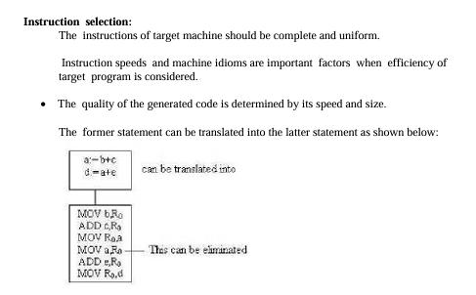

Slide 28
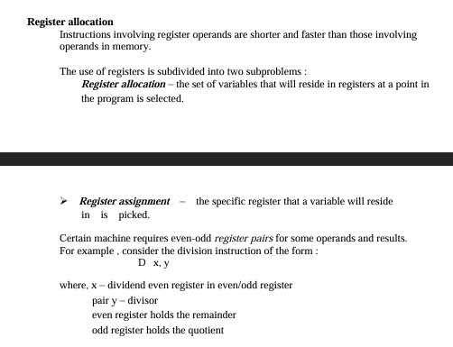

Slide 29


Slide 30
The Simplified Instructional Computer
SIC is hypothetical computer system architecture.
Like many other products, SIC comes in two versions
The standard model
An XE version
“extra equipments”, “extra expensive”
The two versions has been designed to be upward compatible
SIC (Simplified Instructional Computer)
SIC/XE (Extra Equipment)
Note : The two versions have been designed to be upward compatible.

Slide 31
SIC Machine Architecture:
Memory
Registers
Data Formats
Instruction Formats
Addressing Modes
Instruction set
Input and output

Slide 32
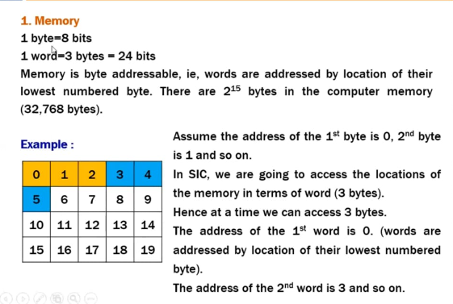

Slide 33
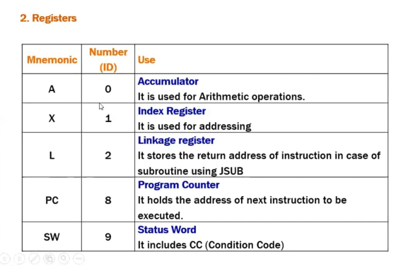

Slide 34
Data Formats
Integers are stored as 24-bit binary number
2’s complement representation for negative values
Characters are stored using 8-bit ASCII codes
No floating-point hardware on the standard version of SIC

Slide 35
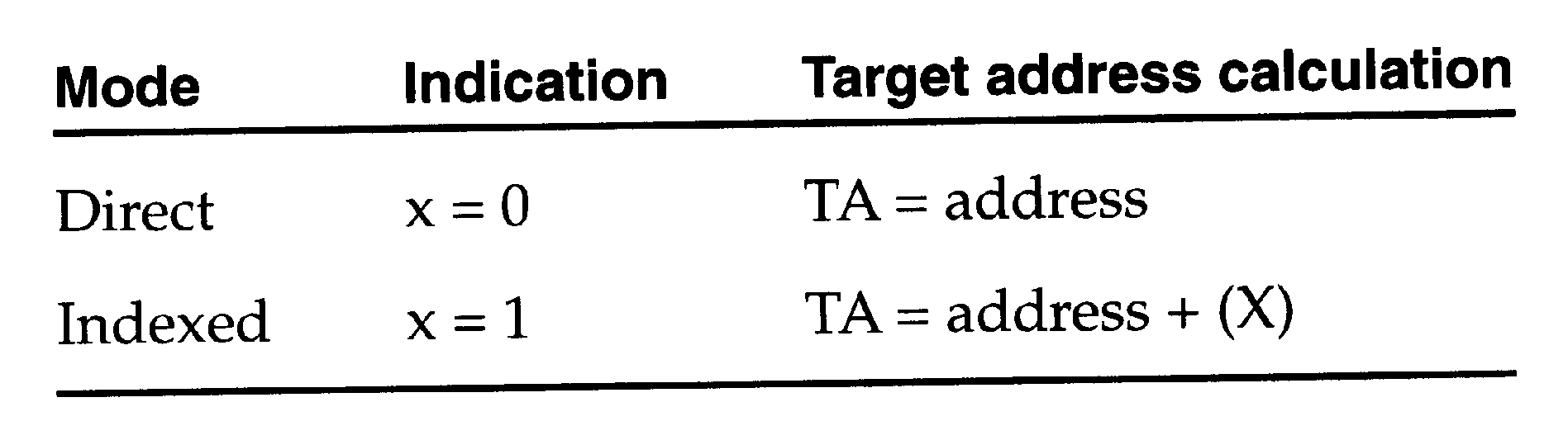
Instruction format
24-bit format
The flag bit x is used to indicate indexed-addressing mode
Addressing Modes
There are two addressing modes available
Indicated by x bit in the instruction
(X) represents the contents of reg. X
8
1
15
opcode
x
address

Slide 36
Example :
LDA TEN (001000)
STCH Buffer ,x
0101 0100 1 001 0000 0000 0000
TA=address+ [x]
0000 0000 0 001 0000 0000 0000

Slide 37
Instruction set
Load and store registers (LDA, LDX, STA, STX, etc.)
Integer arithmetic operations (ADD, SUB, MUL, DIV)
Compare instruction (COMP)
Conditional Codes (CC ) to indicate result like ( < , = , or >)
Conditional jump instructions (JLT, JEQ, JGT)
JSUB jumps to the subroutine, placing the return address in register L.
RSUB returns by jumping to the address contained in register L.

Slide 38
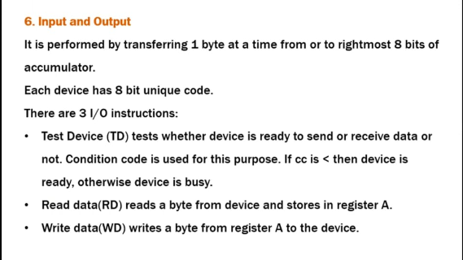

Slide 39
1.3.2 SIC/XE Machine Architecture
Memory
Memory consists of 8-bit bytes, 3 consecutive bytes form a word (24 bits)
All address are byte addresses.
Words are addresses by the location of their lowest numbered byte.
1 megabytes (2^20 bytes) in memory

Slide 40
1.3.2 SIC/XE Machine Architecture
Registers:
9 registers, 24 bits in length
A 0 Accumulator
X 1 Index register
L 2 Linkage register (JSUB)
PC 8 Program counter
SW 9 Status word (Condition Code)
3 additional registers, 24 bits in length
B 3 Base register; used for addressing
S 4 General working register
T 5 General working register
1 additional register, 48 bits in length
F 6 Floating-point accumulator (48 bits)

Slide 41
1.3.2 SIC/XE Machine Architecture
Data format
24-bit binary number for integer.
2’s complement for negative values
Characters are stored using 8bit ASCII code.
48-bit floating-point data type
The exponent is between 0 and 2047
f*2^{(e-1024)}
1
11
36
S
exponent
fraction

Slide 42
1.3.2 SIC/XE Machine Architecture
Instruction Formats :
The larger memory available on SIC/XE , the addresses will no longer fit into 15-bit field.
4 Formats
Format 1 ( 1 byte)
Format 2 ( 2 bytes)
Format 3 ( 3 bytes )
Format 4 ( 4 bytes )

Slide 43
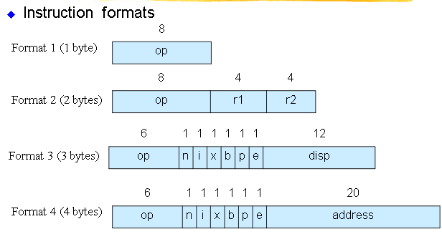

Slide 44
Examples
Format 1 ( 1byte ) :
RSUB 4C 0100 1100
Format 2 ( 2 bytes) : COMPR A, S 1010 0000 0000 0100
Format 3( 3 bytes) : LDA # 3 0000 0001 0000 0000 0000 0011
Format 4( 4 bytes ) : +JSUB RDREC
0100 1011 0001 0000 0001 0000 0011 0110

Slide 45
Addressing modes
n,i,x,b,p,e
n --🡪 indirect addressing flag
I --🡪 Immediate addressing flag
X --🡪 indexed addressing flag
b --🡪 base addressing flag
p --🡪 program counter relative flag
e ---🡪 format 4
e=0 -> format 3
e=1 -🡪format 4

Slide 46
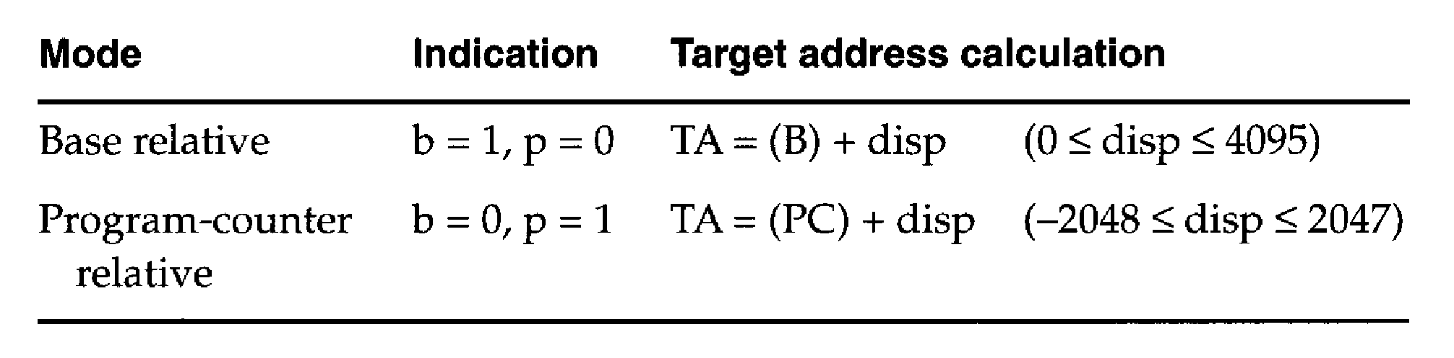
1.3.2 SIC/XE Machine Architecture
Addressing modes
n i x b p e
Simple n=0, i=0 (SIC) or n=1, i=1
Immediate n=0, i=1 TA=Values
Indirect n=1, i=0 TA=(Operand)
Base relative b=1, p=0 TA=(B)+disp
0 <= disp <= 4095
PC relative b=0, p=1 TA=(PC)+disp
-2048 <= disp <= 2047

Slide 47
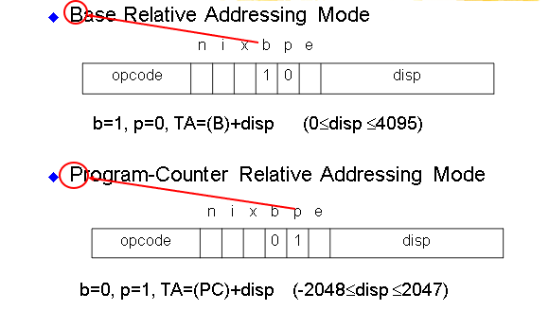

Slide 48
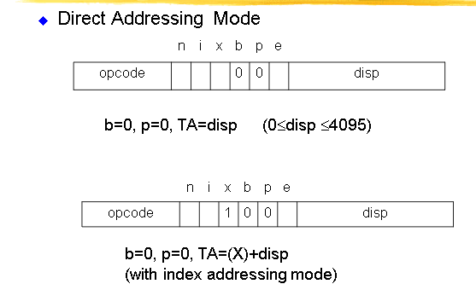

Slide 49
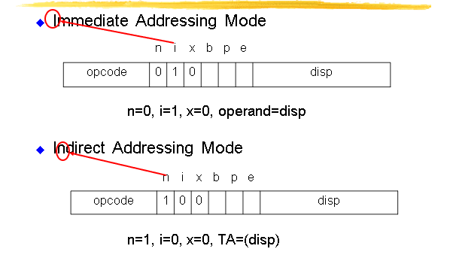

Slide 50
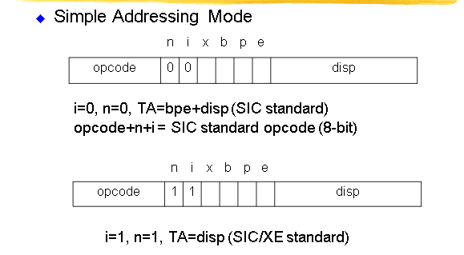

Slide 51
mode | indication | Target address calculation
Base relative | b=1,p=0 n=1,i=1 | TA=(B)+disp (o<=disp<=4095)
Program counter relative | b=0,p=1 n=1,i=1 | TA=(p)+disp (-2048<=disp<=2047
Direct addressing | n=1,i=1 B=0,p=0 (format 3) n=1,i=1 B=0,p=0 (format 4) | TA=displacement TA=address field
Base relative indexed addressing | B=1,p=0,x=1 | TA=(B)+(X)+displacement
program relative indexed addressing | B=0,p=1,x=1 | TA=(p)+(X)+displacement
Immediate addressing | i=1,n=0,x=0 | TA=operand value
Indirect addressing | i=0,n=1,x=0 | TA=diaplacement

Slide 52
Special symbol indication
# ---🡪 immediate addressing
@ ---🡪 Indirect addressing
+ ---🡪 format 4
* ----🡪 current value of PC
C ‘ ‘ --🡪 character string
Op m,x --🡪 index register
Base ---🡪 base register.

Slide 53
NOTE :
We can’t set both b=1 and p=1 which is an invalid instructions.
Indexing cannot be used with immediate or indirect addressing.

Slide 54
1.3.2 SIC/XE Machine Architecture
Instruction set
Format 1, 2, 3, or 4
Load and store registers (LDB, STB, etc.)
Floating-point arithmetic operations (ADDF, SUBF, MULF, DIVF)
Register-to-register arithmetic operations (ADDR, SUBR, MULR, DIVR)
A special supervisor call instruction (SVC) is provided
I/O
1 byte at a time, TD, RD, and WD
SIO, TIO, and HIO are used to start, test, and halt the operation of I/O channels.

Slide 55
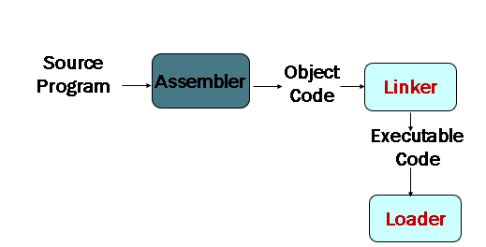
Introduction to Assembler

Slide 56
2.1 Basic Assembler Functions
Figure 2.1 shows an assembler language program for SIC.
The line numbers are for reference only.
Indexing addressing is indicated by adding the modifier “X”
Lines beginning with “.” contain comments only.
Reads records from input device (code F1)
Copies them to output device (code 05)

Slide 57
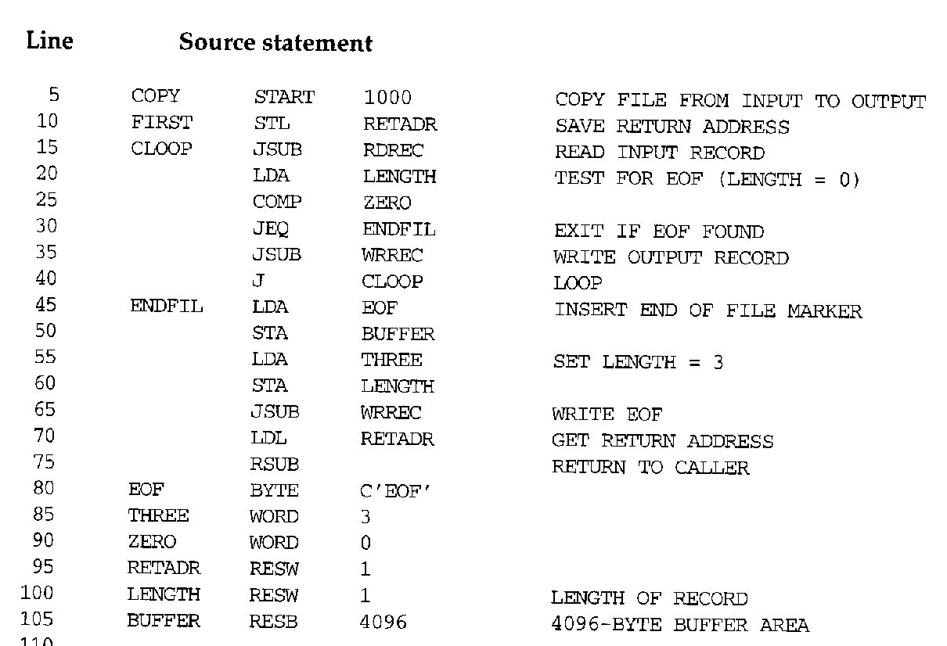

Slide 58
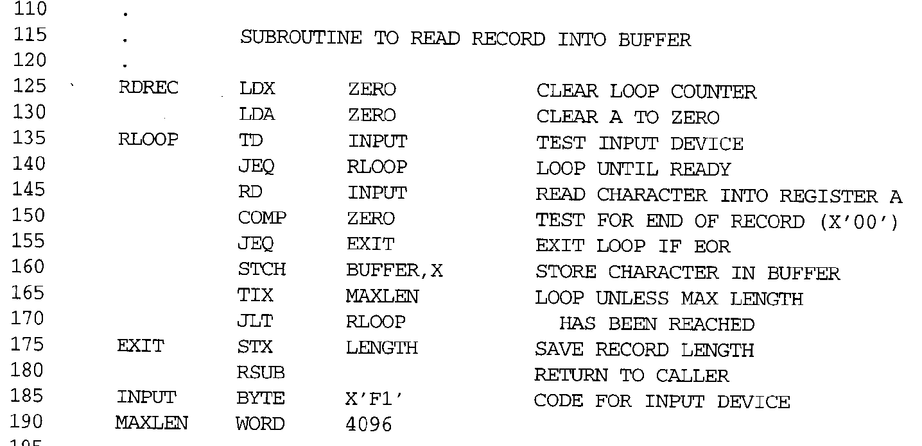

Slide 59
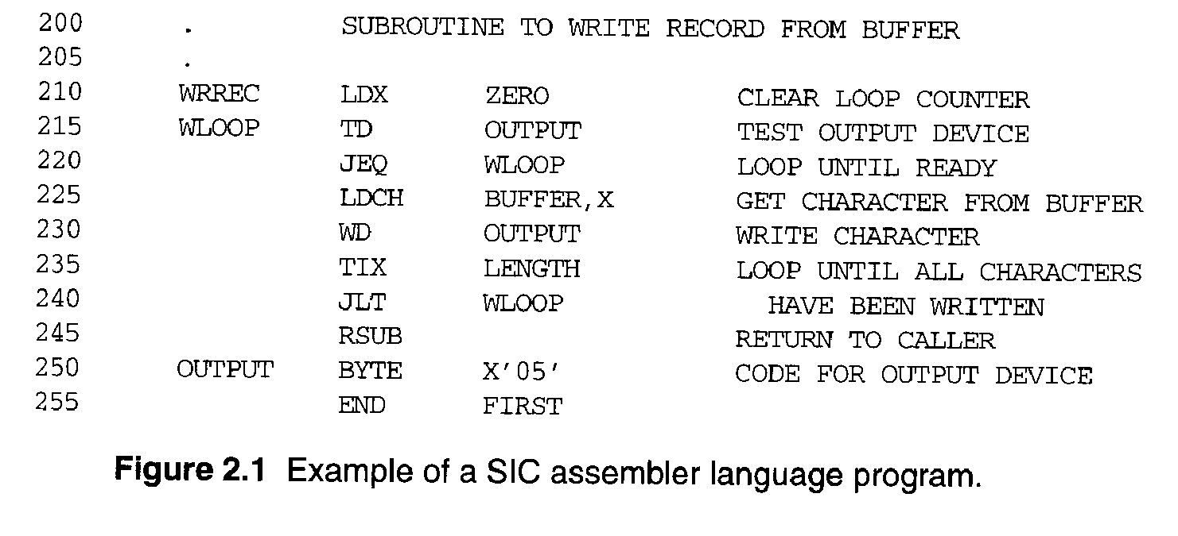

Slide 60
2.1 Basic Assembler Functions
Assembler directives (pseudo-instructions)
START, END, BYTE, WORD, RESB, RESW.
These statements are not translated into machine instructions.
Instead, they provide instructions to the assembler itself.

Slide 61
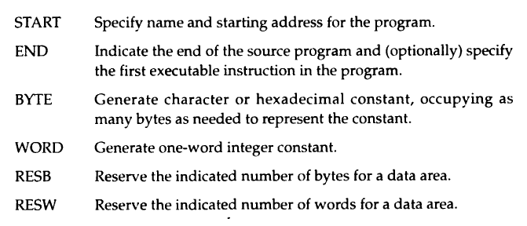

Slide 62
2.1 Basic Assembler Functions
Data transfer (RD, WD)
A buffer is used to store record
Buffering is necessary for different I/O rates
The end of each record is marked with a null character (00₁₆)
Buffer length is 4096 Bytes
The end of the file is indicated by a zero-length record
Subroutines (JSUB, RSUB)
RDREC, WRREC
Save link (L) register first before nested jump

Slide 63
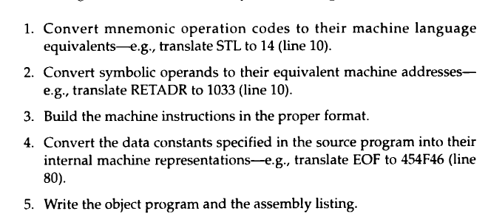
Basic Assembler Functions
The translation of source program to object code requires us to accomplish following functions.

Slide 64
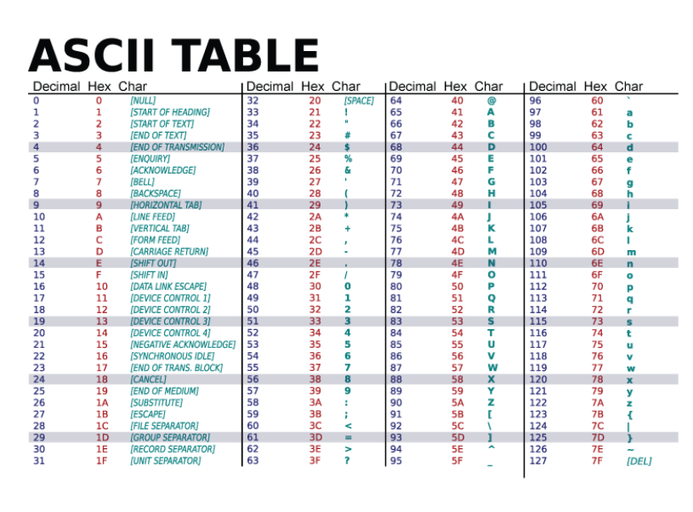

Slide 65
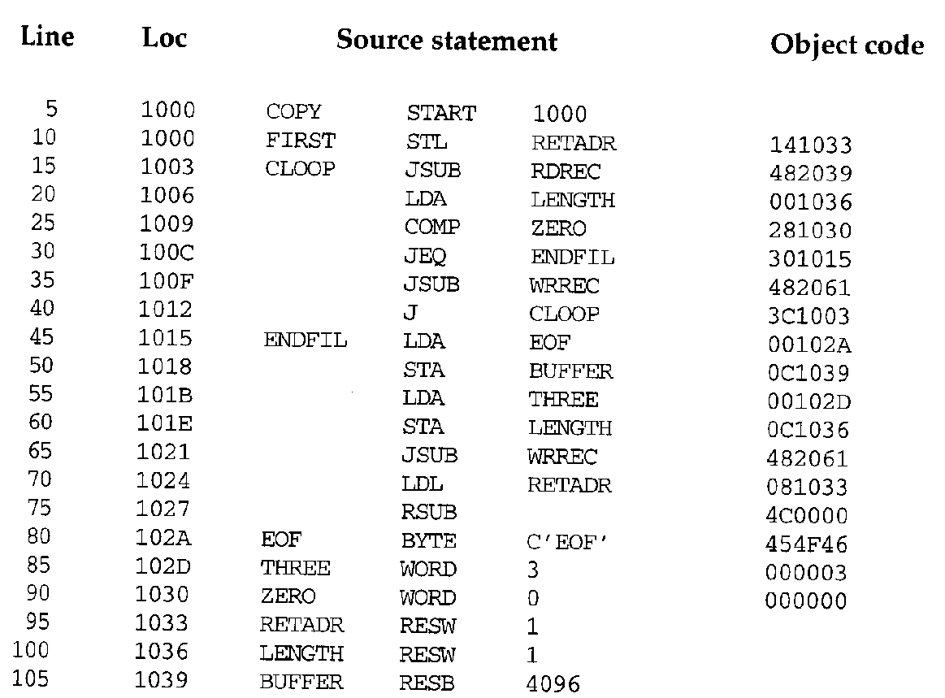

Slide 66
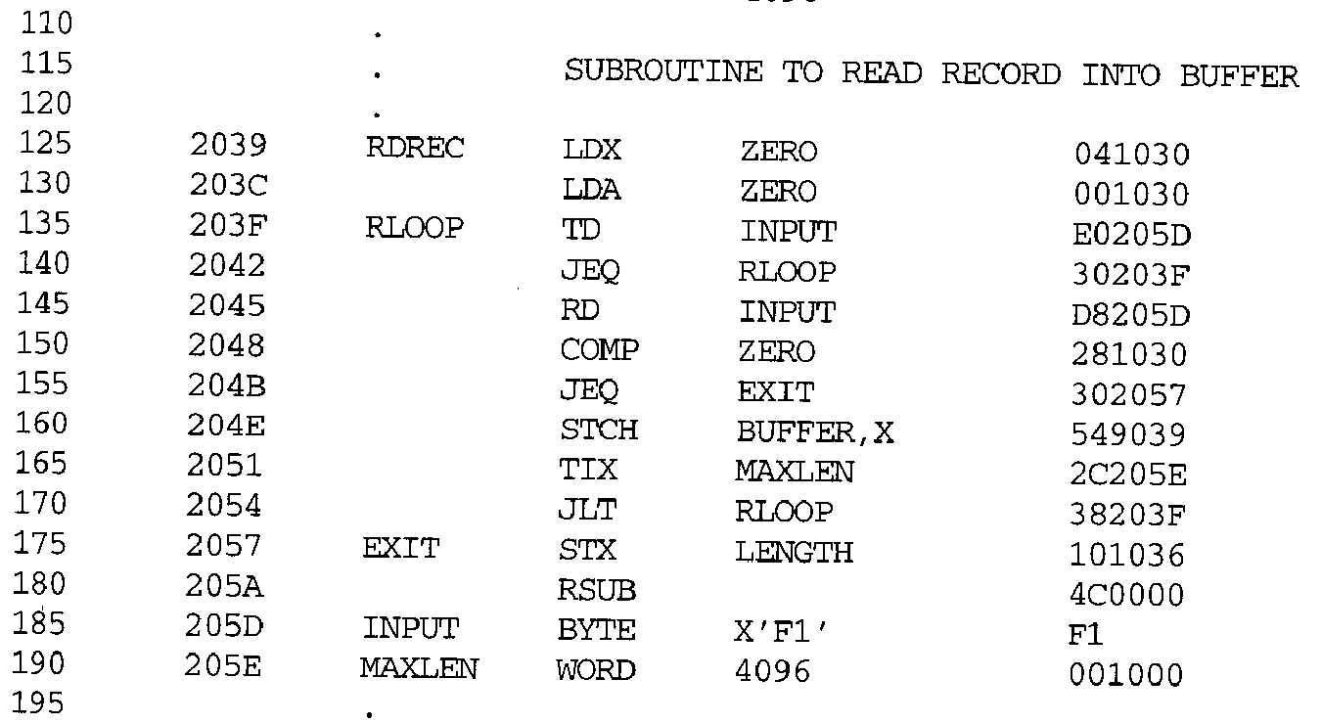

Slide 67
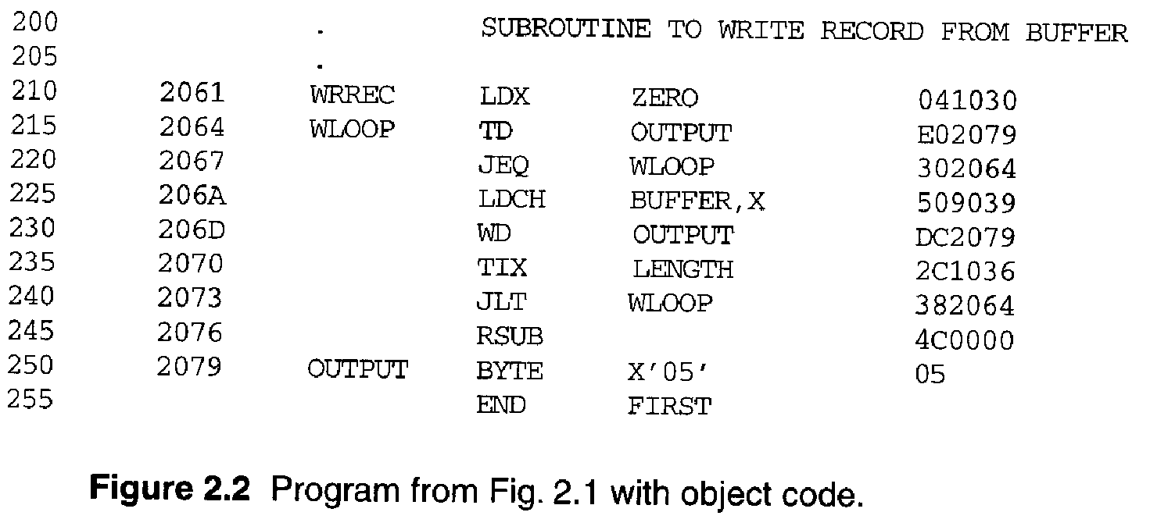

Slide 68
2.1.1 A simple SIC Assembler
A forward reference
10 1000 FIRST STL RETADR 141033
A reference to a label (RETADR) that is defined later in the program
Most assemblers make two passes over source program.
Pass 1 scans the source for label definitions and assigns address (Loc).
Pass 2 performs most of the actual translation.

Slide 69
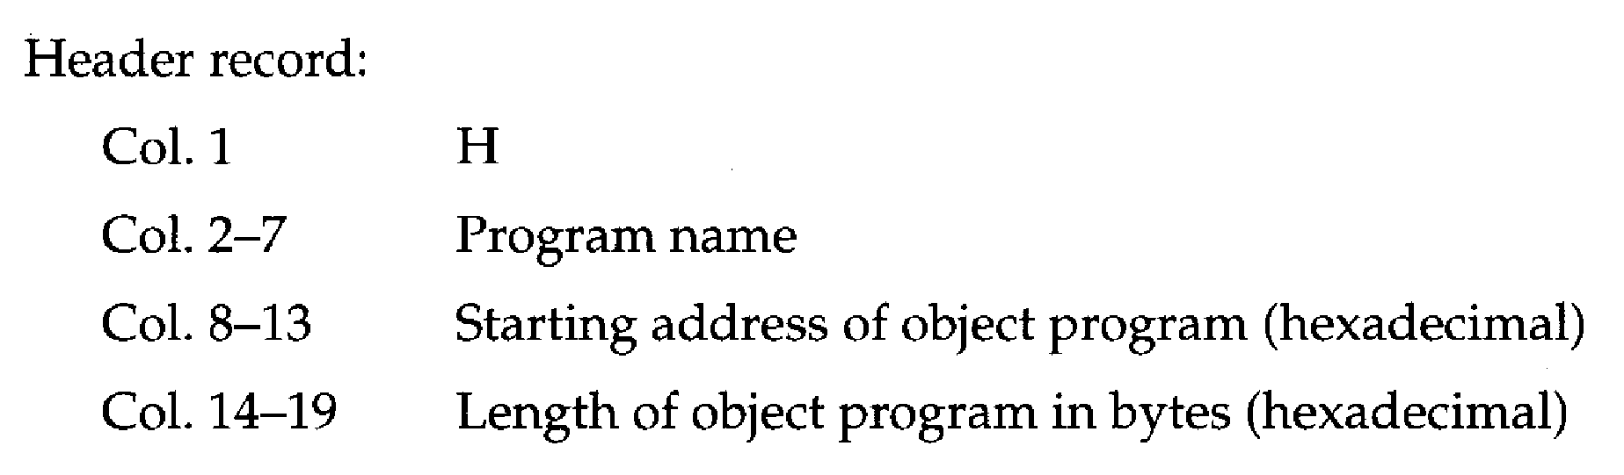
2.1.1 A simple SIC Assembler
The object program (OP) will be loaded into memory for execution.
Three types of records
Header: program name, starting address, length.
Text: starting address, length, object code.
End: address of first executable instruction.

Slide 70
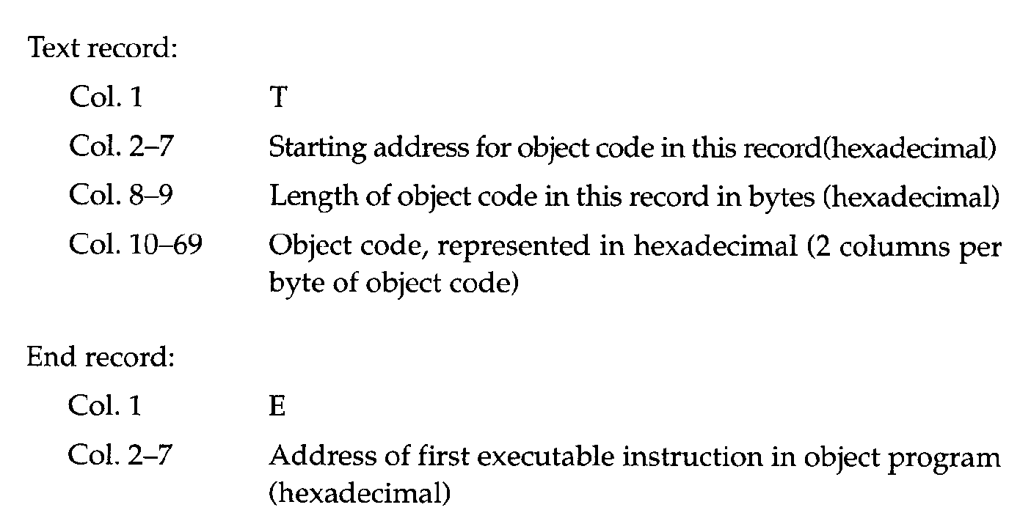
2.1.1 A simple SIC Assembler

Slide 71
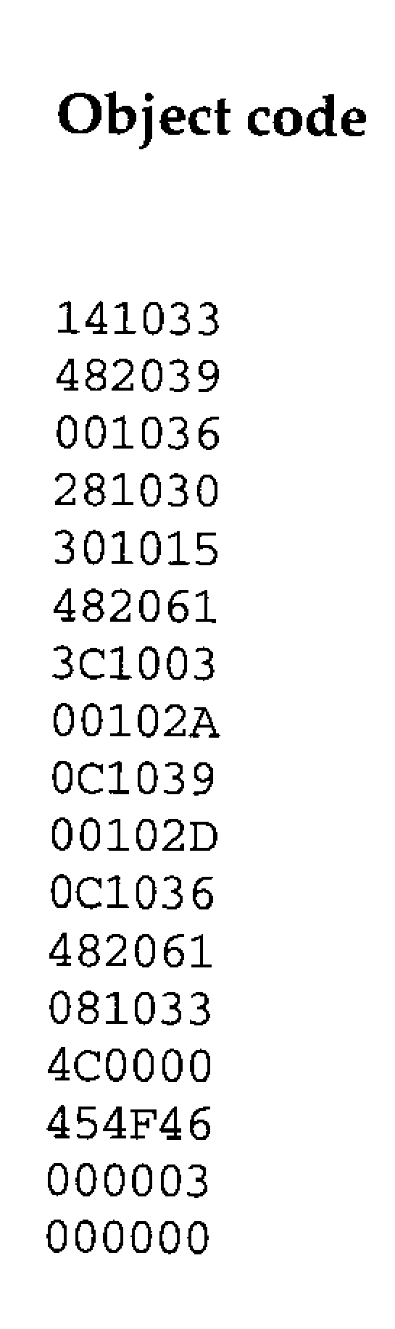
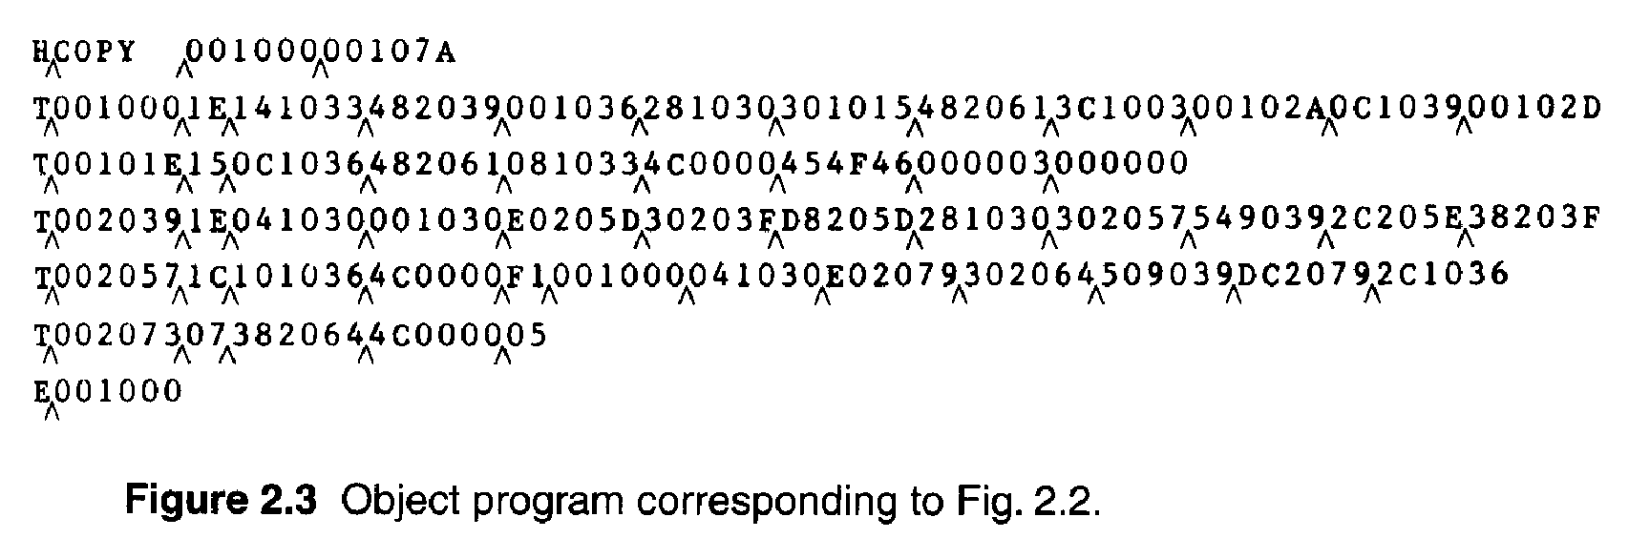
2.1.1 A simple SIC Assembler
The symbol ^ is used to separate fields.
Figure 2.3
1E(H)=30(D)=16(D)+14(D)

Slide 72
2.1.1 A simple SIC Assembler
Assembler’s Functions
Convert mnemonic operation codes to their machine language equivalents
STL to 14
Convert symbolic operands (referred label) to their equivalent machine addresses
RETADR to 1033
Build the machine instructions in the proper format
Convert the data constants to internal machine representations
Write the object program and the assembly listing

Slide 73

2.1.1 A simple SIC Assembler
Example of Instruction Assemble
Forward reference
STCH BUFFER, X
549039
(54)₁₆ 1 (001)₂ (039)₁₆

Slide 74
2.1.1 A simple SIC Assembler
Forward reference
Reference to a label that is defined later in the program.
Loc Label OP Code Operand
1000 FIRST STL RETADR
1003 CLOOP JSUB RDREC
… … … … 1012 J CLOOP
… … … … 1033 RETADR RESW 1

Slide 75
2.1.1 A simple SIC Assembler
The functions of the two passes assembler.
Pass 1 (define symbol)
Assign addresses to all statements (generate LOC).
Save the values (address) assigned to all labels for Pass 2.
Perform some processing of assembler directives.
Pass 2
Assemble instructions.
Generate data values defined by BYTE, WORD.
Perform processing of assembler directives not done during Pass 1.
Write the OP (Fig. 2.3) and the assembly listing (Fig. 2.2).

Slide 76
2.1.2 Assembler Data Structure
Our simple assembler uses two internal tables: The OPTAB and SYMTAB.
OPTAB is used to look up mnemonic operation codes and translate them to their machine language equivalents.
LDA→00, STL→14, …
SYMTAB is used to store values (addresses) assigned to labels.
FIRST→1000, COPY→1000, …
Location Counter LOCCTR
LOCCTR is a variable for assignment addresses.
LOCCTR is initialized to address specified in START.
When reach a label, the current value of LOCCTR gives the address to be associated with that label.

Slide 77
2.1.2 Assembler Tables and Logic
The Operation Code Table (OPTAB)
Contain the mnemonic operation & its machine language equivalents (at least).
Contain instruction format & length.
Pass 1, OPTAB is used to look up and validate operation codes.
Pass 2, OPTAB is used to translate the operation codes to machine language.
In SIC/XE, assembler search OPTAB in Pass 1 to find the instruction length for incrementing LOCCTR.
Organize as a hash table (static table).

Slide 78
2.1.2 Assembler Tables and Logic
The Symbol Table (SYMTAB)
Include the name and value (address) for each label.
Include flags to indicate error conditions
Contain type, length.
Pass 1, labels are entered into SYMTAB, along with assigned addresses (from LOCCTR).
Pass 2, symbols used as operands are look up in SYMTAB to obtain the addresses.
Organize as a hash table (static table).
The entries are rarely deleted from table.
COPY 1000
FIRST 1000
CLOOP 1003
ENDFIL 1015
EOF 1024
THREE 102D
ZERO 1030
RETADR 1033
LENGTH 1036
BUFFER 1039
RDREC 2039

Slide 79
2.1.2 Assembler Tables and Logic
Pass 1 usually writes an intermediate file.
Contain source statement together with its assigned address, error indicators.
This file is used as input to Pass 2.
Figure 2.4 shows the two passes of assembler.
Format with fields LABEL, OPCODE, and OPERAND.
Denote numeric value with the prefix #.
#[OPERAND]

Slide 80
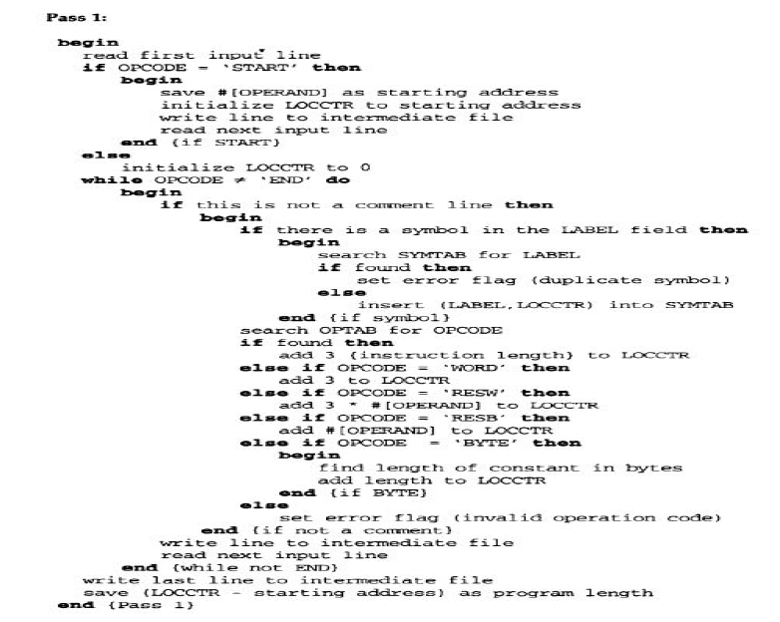

Slide 81
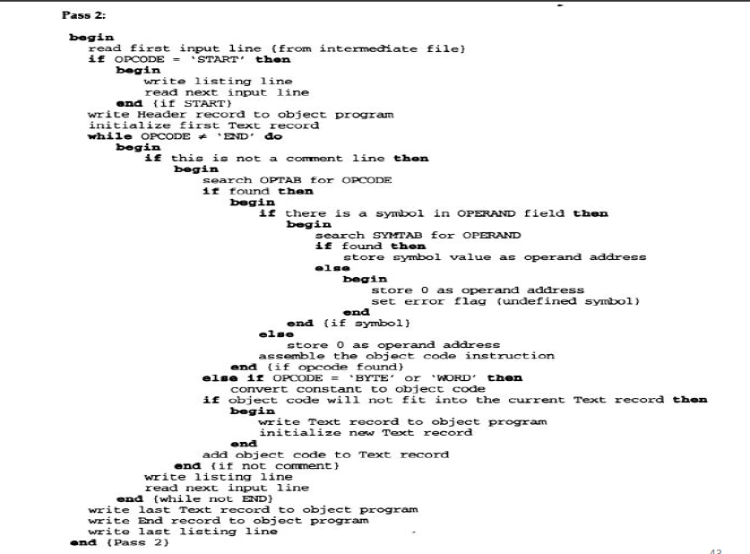

Slide 82
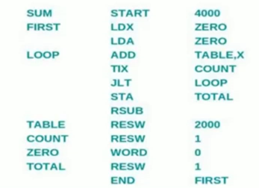
SIC Example 1:

Slide 83
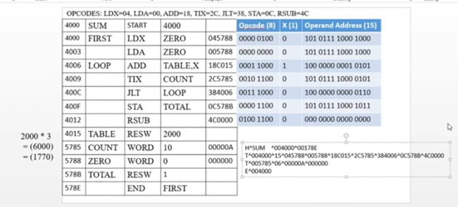

Slide 84
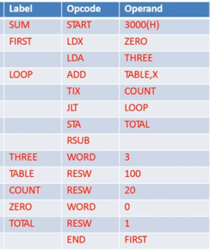
SIC Example 2:

Slide 85
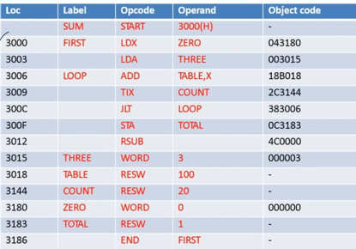

Slide 86

SIC/XE Example 1:

Slide 87

SIC/XE Example 2:

